Slide 1
Priority Queue
CSE 2050
Ahmad Jbara
University of Connecticut

Slide 2
Priority queue
In queue items are removed according to their order of insertion
Priority queue resembles a queue except that items have a priority
Items will come out ordered by their priority
We will provide a few implementations for the priority queue ADT

Slide 3
The priority queue ADT
PQ ADT is a data type that stores a collection of items with priorities
It supports the following operations
Operation | Description
PQ() | creates a new empty priority queue
insert(item, priority) | Add an item with the given priority
findmin() | Returns the item with the minimum priority
removemin() | Removes and returns the item with the minimum priority

Slide 4
Implementation using list
class SimpleListPQ:
def __init__(self):
self._L = []
def insert(self, item, priority):
self._L.append((item, priority))
def findmin(self):
return min(self._L, key = lambda x : x[1])[0]
def removemin(self):
item, priority = min(self._L, key = lambda x : x[1])
self._L.remove((item, priority))
return item

Slide 5
Implementation using list - refactored
class UnsortedListPQ:
def __init__(self):
self._entries = []
def insert(self, item, priority):
self._entries.append(Entry(item, priority))
def findmin(self):
return min(self._entries).item
def removemin(self):
entry = min(self._entries)
self._entries.remove(entry)
return entry.item
class Entry:
def __init__(self, item, priority):
self.priority = priority
self.item = item
def __lt__(self, other):
return self.priority < other.priority

Slide 6
Implementation using list - analysis
class UnsortedListPQ:
def __init__(self):
self._entries = []
def insert(self, item, priority):
self._entries.append(Entry(item, priority))
def findmin(self):
return min(self._entries).item
def removemin(self):
entry = min(self._entries)
self._entries.remove(entry)
return entry.item
O(1)
O(n)
O(n)
class Entry:
def __init__(self, item, priority):
self.priority = priority
self.item = item
def __lt__(self, other):
return self.priority < other.priority

Slide 7
Implementation using list – last attempt
class SortedListPQ:
def __init__(self):
self._entries = []
def insert(self, item, priority):
self._entries.append(Entry(item, priority))
self._entries.sort(reverse = True)
def findmin(self):
return self._entries[‑1].item
def removemin(self):
return self._entries.pop().item
X
O(1)
O(1)
O(1)

Slide 8
Implementation using list – last attempt
class SortedListPQ:
def __init__(self):
self._entries = []
def insert(self, item, priority):
self._entries.append(Entry(item, priority))
self._entries.sort(reverse = True)
def findmin(self):
return self._entries[‑1].item
def removemin(self):
return self._entries.pop().item
O(?) depends on the time to sort
O(1)
O(1)
Python sort could take O(nlogn)
Good implementation of insertion sort could take linear time

Slide 9
Back to binary search tree - BST
class BinarySearchTree:
class __Node:
def __init__(self,val,left=None,right=None):
self.val = val
self.left = left
self.right = right
def insert(self,val):
def __insert(root,val):
if root == None:
return BinarySearchTree.__Node(val)
if val < root.getVal():
root.setLeft(__insert(root.getLeft(),val))
else:
root.setRight(__insert(root.getRight(),val))
return root
self.root = __insert(self.root,val)

Slide 10
Back to binary search tree - BST
class BinarySearchTree:
class __Node:
def __init__(self,val,left=None,right=None):
self.val = val
self.left = left
self.right = right
def findMin(self):
if self.left == None:
return self.val
return self.left.findMin()
def findMin(self):
return self.root.findMin()

Slide 11
Back to binary search tree - BST
class BinarySearchTree:
class __Node:
def __init__(self,val,left=None,right=None):
self.val = val
self.left = left
self.right = right
def remove(self, item):
if item < self.val:
self.left = self.left.remove(item)
elif item > self.val:
self.right = self.right.remove(item)
else:
if self.left == None:
return self.right
elif self.right == None:
return self.left
self.val = self.right.findMin()
self.right = self.right.remove(self.val)
return self

Slide 12
Back to binary search tree - BST
class BinarySearchTree:
def remove(self, item):
if self.root != None:
self.root = self.root.remove(item)
def main():
lst = [8, 2, 1, 6, 5,12]
tree = BinarySearchTree()
for x in lst:
tree.insert(float(x))
tree.remove(2)
if __name__ == "__main__":
main()

Slide 13
Search tree analysis – the insert method
The limiting factor on its performance is the height of the tree
Searching the place to put the new node we need one comparison at each level
The height of the tree depends on how the keys are added
Random order
Keys are randomly distributed
About half of the keys will be less than the root and half will be greater than the root
Performance will be O(logn)

Slide 14
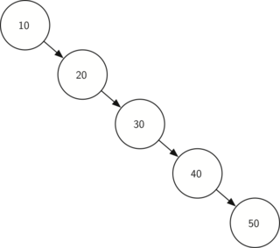
Search tree analysis – the insert method
Sorted order
Keys are added in a sorted order
All keys will be added to the left or to the right
Performance will be O(n)

Slide 15
Search tree analysis – other methods
The insert method is limited by the height
We can guess that other methods are limited as well
Searching a key
You search the tree to find a key
Worst case: the tree is searched all the way to the bottom and no key is found
Removing a key
It seems more complicated
But…

Slide 16
Implementing PQ using BST
Operation | Description
PQ() | creates a new empty priority queue
insert(item, priority) | Add an item with the given priority
findmin() | Returns the item with the minimum priority
removemin() | Removes and returns the item with the minimum priority

Slide 17
Balanced binary search tree
We learned that the performance of a binary search tree can degrade to O(n) when the tree becomes unbalanced
We will look at a special kind of binary search tree that automatically keeps the tree balanced – AVL trees.

Slide 18
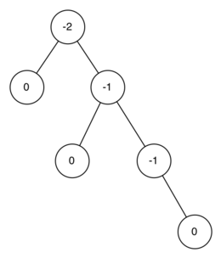
The balance factor for a node
The balance factor for a node is
Difference between the height of the left subtree and the height of the right subtree

Slide 19
Balanced tree
A tree is in balance if the balance factor is: -1, 0, 1
If the balance factor of a node is outside this range we need to bring the tree back into balance - rebalance

Slide 20
AVL tree implementation
Keeping a tree in balance will give us a big performance improvement
All new keys are inserted as leaf nodes
The balance factor for a new leaf node is zero – no action is needed
However, we need to update the balance factor of its parent
If the new node is a right child the balance factor of its parent is reduced by 1
If the new node is a left child the balance factor of its parent is increased by 1
This procedure can be applied to every ancestor all the way to the root

Slide 21
Update balance factor
def updateBalance(self,node):
if node.balanceFactor > 1 or node.balanceFactor < -1:
self.rebalance(node)
return
if node.parent != None:
if node.isLeftChild():
node.parent.balanceFactor += 1
elif node.isRightChild():
node.parent.balanceFactor -= 1
if node.parent.balanceFactor != 0:
self.updateBalance(node.parent)

Slide 22
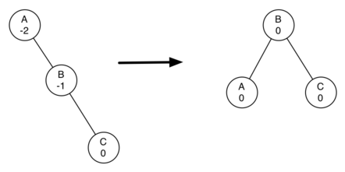
Rebalancing
In order to bring a tree back into balance we will perform one or more rotations on the tree
The tree in the left is out of balance – balance factor is -2
To bring it into balance we perform left rotation around the subtree rooted at A

Slide 23
Rebalancing
Left rotation
Promote the right child, B, to be the root of the subtree
Move the old root, A, to be the left child of the new root
If new root, B, had a left child then make it the right child of the new left child A

Slide 24
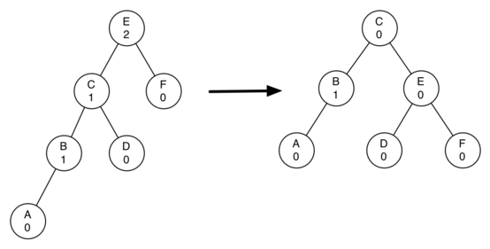
Rebalancing
Right rotation
Promote the left child (C) to be the root of the subtree.
Move the old root (E) to be the right child of the new root.
If the new root (C) already had a right child (D) then make it the left child of the new right child (E).

Slide 25
Rebalancing
def rotateLeft(self,rotRoot):
newRoot = rotRoot.rightChild
rotRoot.rightChild = newRoot.leftChild
if newRoot.leftChild != None:
newRoot.leftChild.parent = rotRoot
newRoot.parent = rotRoot.parent
if rotRoot.isRoot():
self.root = newRoot
else:
if rotRoot.isLeftChild():
rotRoot.parent.leftChild = newRoot
else:
rotRoot.parent.rightChild = newRoot
newRoot.leftChild = rotRoot
rotRoot.parent = newRoot

Slide 26
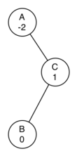
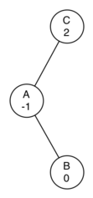
Rebalancing - one more example
Node A has a balance factor of -2
We should do a left rotation
What happens when we do a left rotation around A

Slide 27
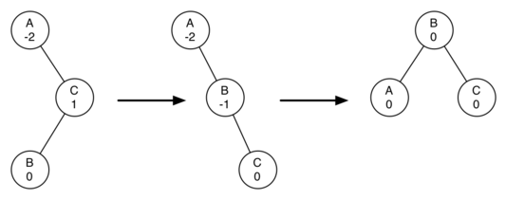
Rebalancing – new rules
If a subtree needs a left rotation to bring it into balance, first check the balance factor of the right child. If the right child balance factor is positive then do a right rotation on right child, followed by the original left rotation.
If a subtree needs a right rotation to bring it into balance, first check the balance factor of the left child. If the left child balance factor is negative then do a left rotation on the left child, followed by the original right rotation.

